Slide 1
When Helping Hurts

Slide 2
Opener
  Think about the under-resourced people in our community who have asked you or Northeast for financial assistance. Under what conditions would you give things or money to these people?
  Think about any ministry to the materially poor that Northeast has conducted on a short-term mission trip. Under what conditions would you or Northeast give things or money to these people?

Slide 3
Opener
Are your answers to the previous two questions the same or different? Why?

Slide 4
The point:
Not all poverty is created equal!
There is not a one-size-fits-all approach to poverty! You must understand the root cause of the poverty.
An Example:
Eastern KY Flooding – lack food, water, clothing, and shelter
Low-income community in our city with exact same issues – they need the same thing
The obvious answer is to give both what they need. Right?

Slide 5
A Summary of some “When Helping Hurts” Principles
When we encounter poverty, we want to __________.
Unfortunately, our good deeds can often _________.

Slide 6
A different ________________ of poverty
  Most Americans define poverty in ___________ terms – a lack of income, health care, housing, food and wealth – a lack of some material thing.
  If we ask under-resourced people around the world: “what is poverty?”, they answer the question differently than most N. Americans – they tend to describe poverty in _____________, _____________, or _________________ terms (feel inferior, voice means nothing, feelings of shame, a belief that things can’t get better and so on).
  This is not simply an academic question: the way we _______________ poverty determines the ________________________ that we use to alleviate poverty.
  Must treat underlying ____________ - Treating the _______________ of poverty instead of the underlying _______________ can result in disaster
A Summary of some “When Helping Hurts” Principles

Slide 7
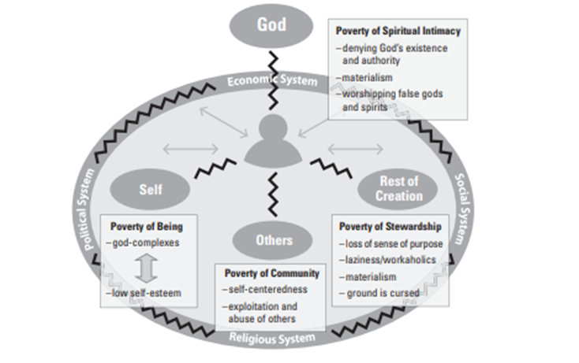
A Summary of some “When Helping Hurts” Principles
Four key Relationships

Slide 8
A Summary of some “When Helping Hurts” Principles
Definition/Foundational Nature of Poverty
Poverty is the result of relationships that:
    Do not work
    That are not just
    That are not for life
    That are not harmonious or enjoyable
Poverty is the absence of shalom in all its meanings.

Slide 9
A Summary of some “When Helping Hurts” Principles
Poverty Alleviation
  Poverty alleviation is the ministry of _______________________: moving people closer to glorifying God by living in right relationship with:
    __________________________
    __________________________
    __________________________
    __________________________

Slide 10
Questions
Please discuss the following questions in your groups:
Why did Jesus come to earth?
For what specific sins was OT Israel sent into captivity? Be specific.
What is the primary task of the Church?

Slide 11
Biblical Framework for When
Helping Hurts
Why did Jesus come to earth?
Jesus is the ____________________ of _______________________
Biblical reference _____________________

Slide 12
Biblical Framework
for When
Helping Hurts
What is the task of the Church?
The task of God’s people is _________ in Christ’s ______________.
To be the very ___________________ of _________________.
Biblical references _____________________; _____________________

Slide 13
Healthy Poverty Response
There are three types of responses to poverty:
  Relief
  Rehabilitation
  Development

Slide 14
Healthy Poverty Response
Relief: an effort to stop the ___________.
  It is the _____________ and _______________ provision of emergency aid to reduce immediate suffering from a natural or man-made crises, and
  It primarily utilizes a _______________ - ________________ dynamic.
  Examples? __________________________________________________________________________________________________________________

Slide 15
Healthy Poverty Response
Rehabilitation: An effort to _______________ people back to their pre-crisis state after the initial bleeding has stopped.
  In rehabilitation, people begin to _________________ to improving their situation.
  Global Example: __________________________________________________________________________
  Local Example: _______________________________________________________________________________________________________________

Slide 16
Healthy Poverty Response
Development: Walking __________ people across time in ways that move all the people involved – both the “_______________” and the “_________________” – closer to being in right relationship with God, self, others, and the rest of creation than they were before.
  It avoids “________________ __________” and focuses on “______________________.”
  Example: __________________________________________________________________________________________________________________

Slide 17
Development (cont.)
Key in development work – promote an empowering process. The ___________________ is what matters.
  Global Example – 2 short-term mission trips
    Produce a ___________ – Build 3 houses and give away – Come back and celebrate – with photos, etc.
    Empowering ___________ – Only go if asked; works with locals to build three homes and asks them, “how should we do it?” Build the homes with the locals, even though it isn’t a great plan; problem solve together.
  Local Example – Christmas party
    Prior – Give away gifts – ______________ was a toy we bought and gave away
    After – Work with social worker to identify who is truly in need and then have parents attend classes, earning vouchers to buy gifts – __________________ of working with a family
Healthy Poverty Response

Slide 18
Paternalism
When we apply relief, rehabilitation, and development _____________________, we do more than just give people wrong things.
We set up a ______________________ dynamic of paternalism.
Paternalism Definition: __________________ doing things for people that they can do for _____________.

Slide 19
Paternalism
Types:
Resource – ______________________________________________________________________________________
Spiritual – ______________________________________________________________________________________
Knowledge – ______________________________________________________________________________________
Labor – ______________________________________________________________________________________
Managerial – ______________________________________________________________________________________

Slide 20
The Challenge of not being Paternal
Why would it be easier just to do things for people?
____________________________________________________________________________________________________________________________________

Slide 21
Ministry Assessment
Make a list of the ministries that you have been involved in within the community and/or globally. Next to each ministry/trip, write whether they are providing relief, rehabilitation, or development.
Now, think about the materially poor individuals/communities each ministry is attempting to reach. Do their circumstances require relief, rehabilitation or development? Are your ministries providing the appropriate intervention? If not, what changes could you make to improve your approach
For the ministries you mentioned above, discuss whether any forms of paternalism make an appearance in your work. If so, in what ways could you modify the ministry to make it more effective and appropriate?

